Slide 1
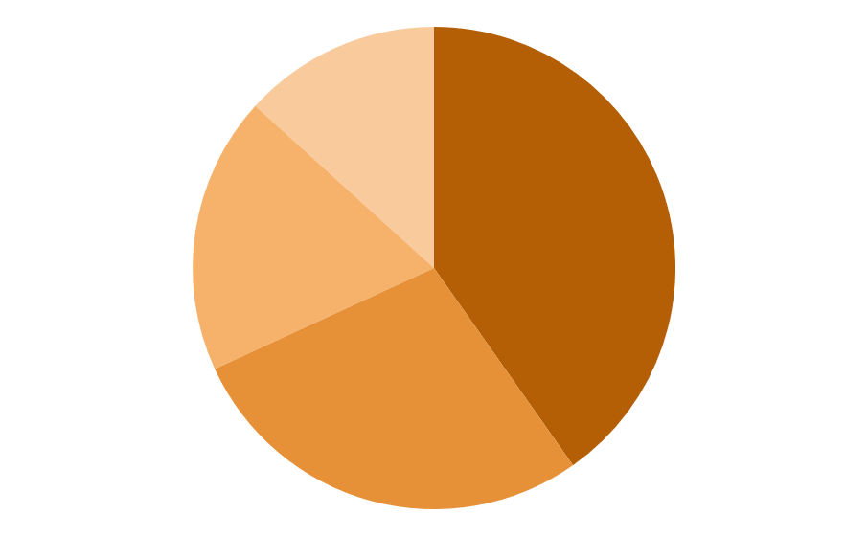
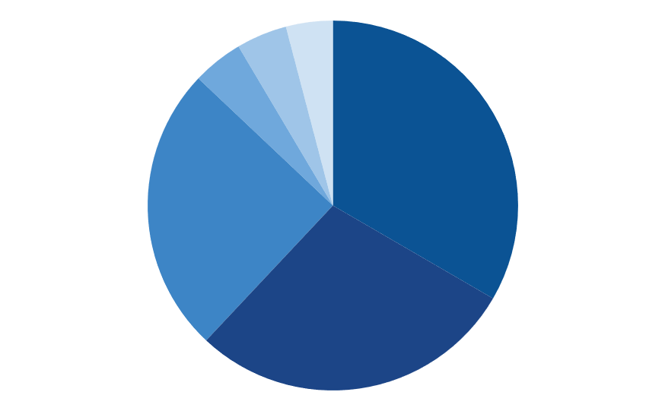
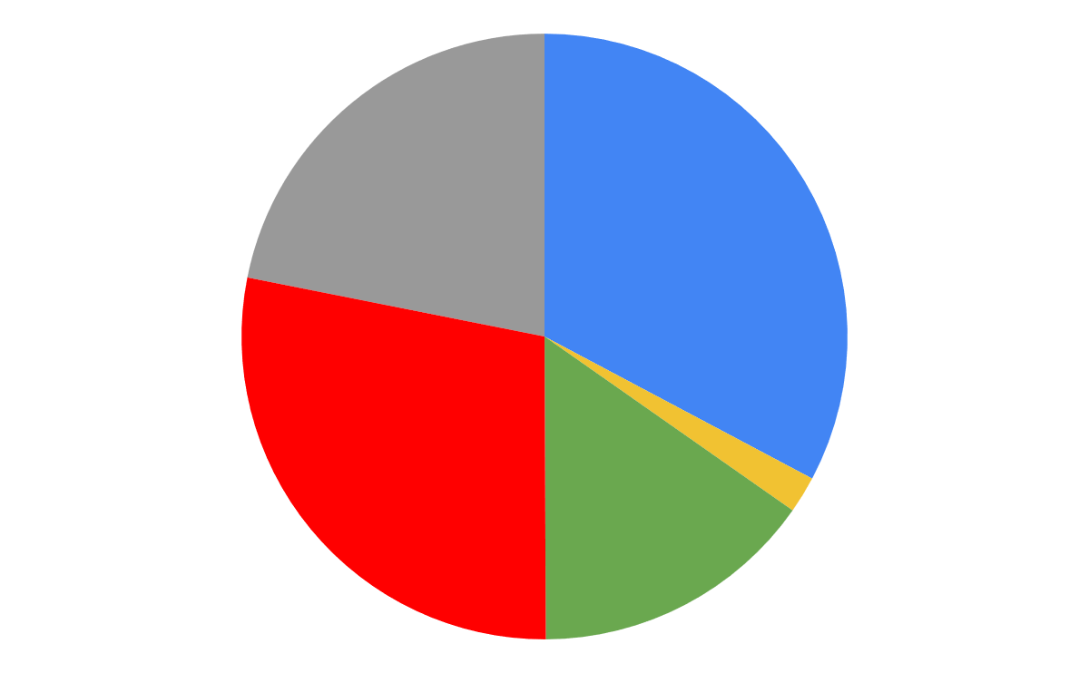
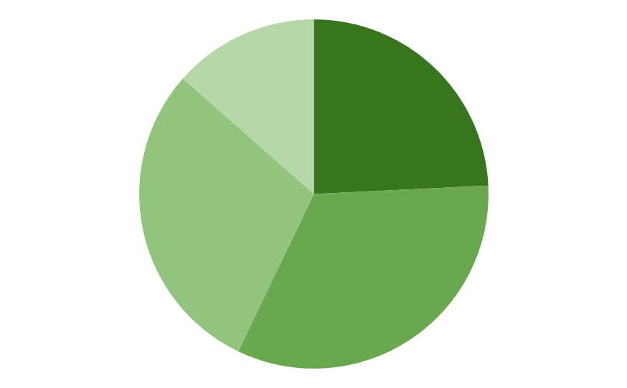
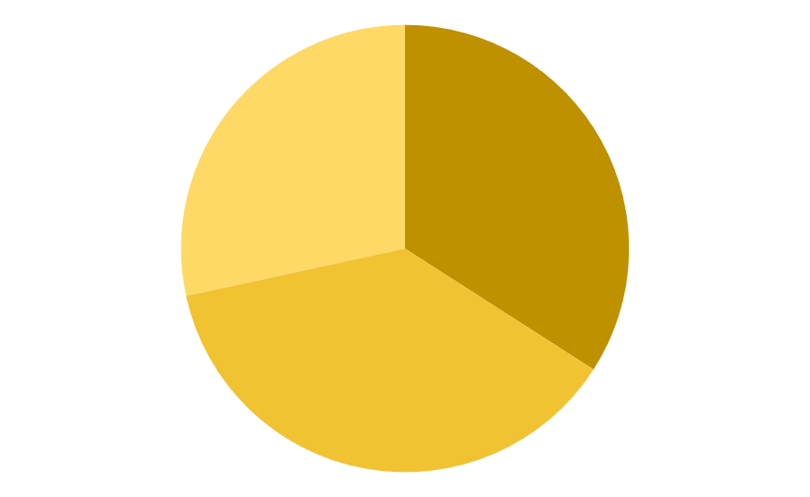
Previsionnal Expenses
Suspension Budget
Powertrain Budget
14 680€
12 630€
Steering system 13%
Fuel system 4%
Cooling system 4%
Intake system 5%
Engine & accessories 33%
Brake system 19%
Wheels and Tires 40%
51 800€
Exhaust system 25%
Secondary drivetrain system 29%
Dampers 28%
Miscellaneous* 22%
33%
Electrical Budget
28%
2%
Frame Budget
880 €
6 810€
15%
Data acquisition 14%
Crash box
28%
Frame bending
34%
Other (ECU, Battery…) 24%
electronic 30%
Gear Shift 25%
Paint
38%
*Miscellanous: competition cost, campings, bolts, imponderables,…

Slide 2
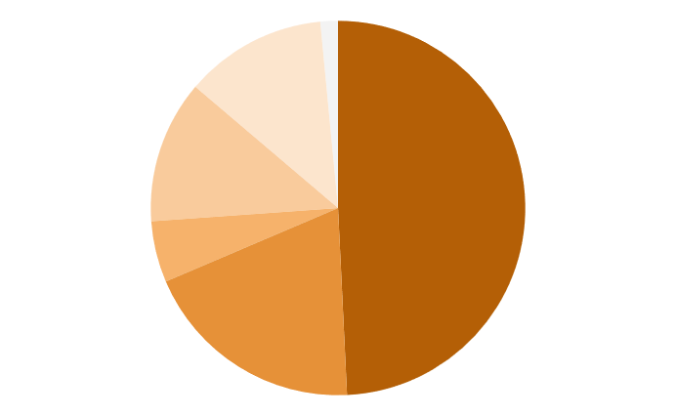
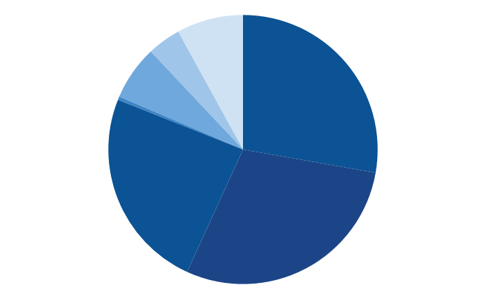
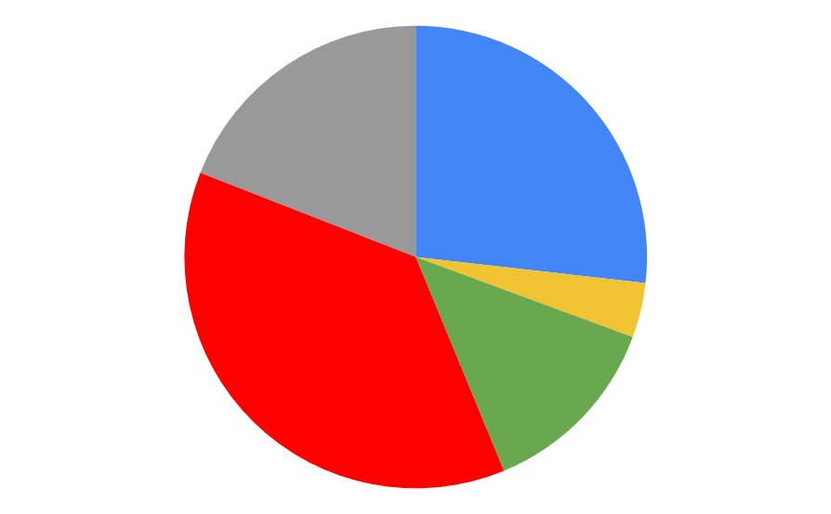
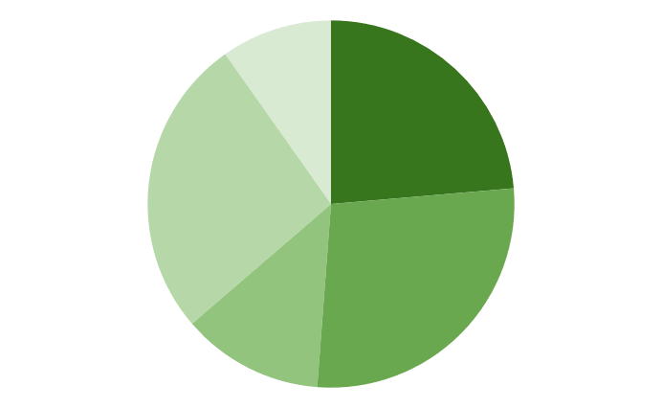
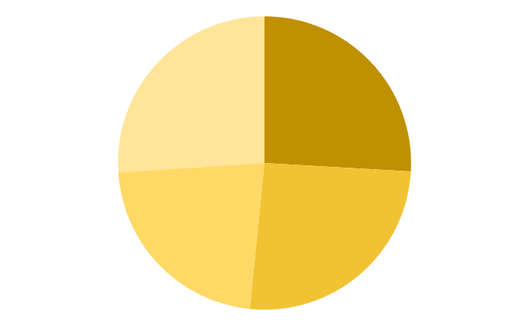
Overview Expenses
Suspension Budget
Powertrain Budget
14 046€
19 480€
A_arms 12%
Miscellaneous 2%
Miscellaneous 8%
Cooling system 4%
Engine & accessories 28%
Fuel system 7%
Steering system 12%
Intake system ≈0%
Wheels and Tires 49%
Brake system 5%
52 418€
Exhaust system 24%
Secondary drivetrain system 29%
Miscellaneous* 19%
27%
Dampers 20%
Electrical Budget
37%
4%
Frame Budget
2 005 €
6 893€
13%
Miscellaneous 8%
Bodywork 26%
Rigidity tests
26%
Other (ECU, Battery…) 20%
Data acquisition 22%
Gear Shift 39%
Paint
22%
Frame 26%
Electronic 11%
*Miscellanous: competition cost, campings, bolts,…

Slide 3
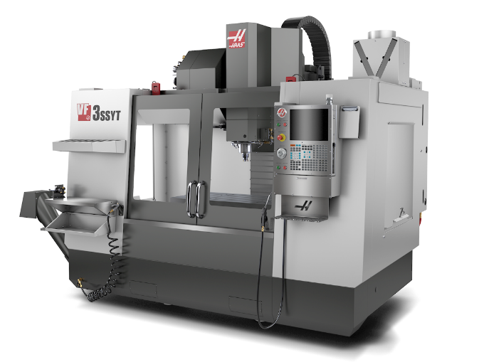
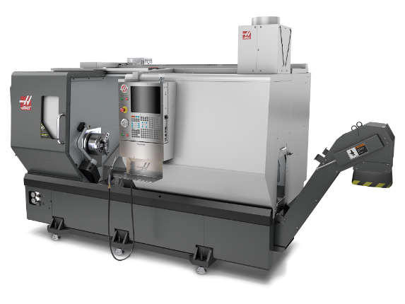
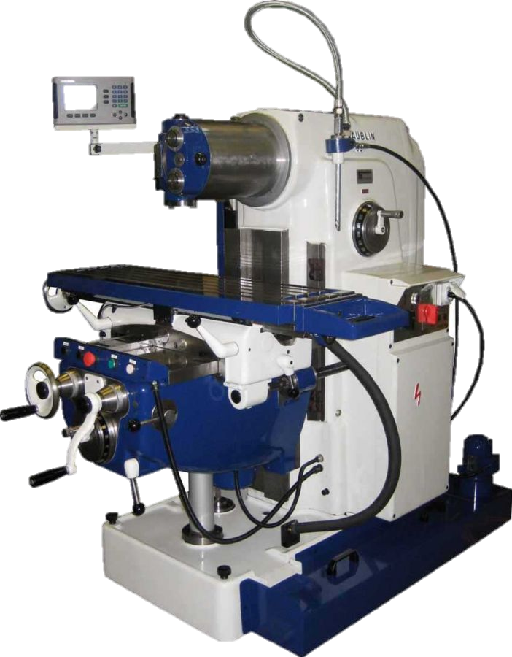
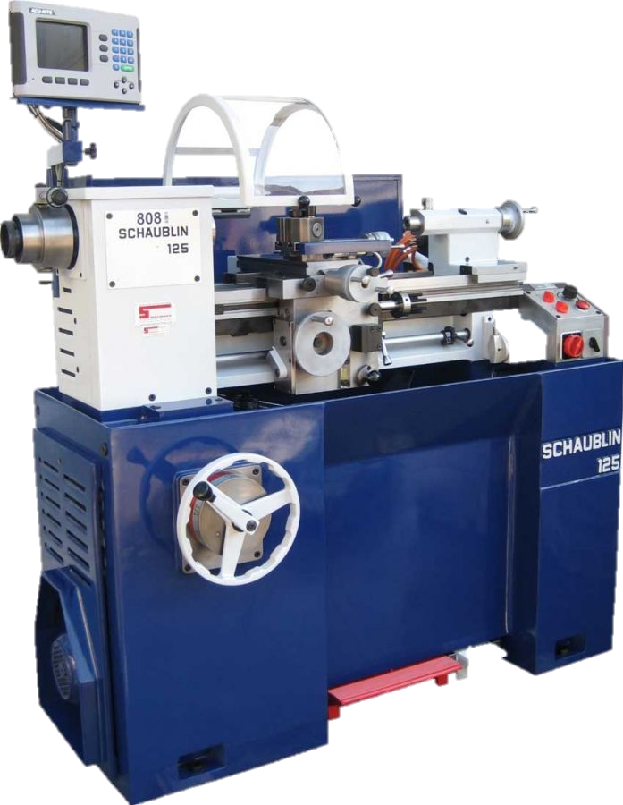
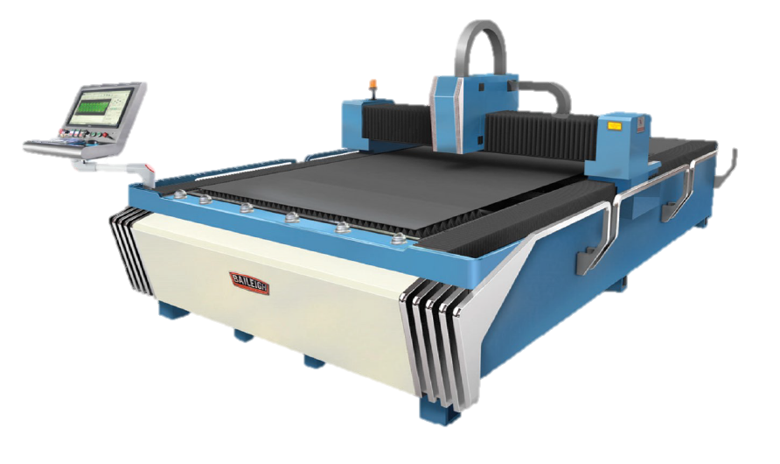

Workshop organisation
Haas VF-3SSYT
3 Axis CNC vertical milling machine
Power: 22.4kW
12 000 rpm inline direct drive
1016 x 660 x 718 mm max capacity
Tool changer capacity: 30+1
Additional 4th axis
Probe system for easier tool setup
Haas ST-35Y
CNC lathe with Y axis
Power: 29,8kW
3200 rpm spindle
457 x 584 mm max capacity
305 mm hydraulic chuck
24 station turret with 4000 rpm live tooling
Probe system for easier tool setup
Parts catcher
Conventional mill and lathe
Manpower
4 operator full-time and 1 operator part-time
Machine supervision
Assemblies (except welding)
Maintenance
Simple CAM/metrology
1 technician
Complex CAM/metrology
1 welder
1 engineer
General organisation
Sales
Complex CAM/metrology
1 administrative
Sales, supplies, invoices,…
Office :
Administrative
Sales
Development
Storage Area :
Materials stock
Consumables
Parts to assemble
Tooling
Critical spare parts
…
Staff room
Metrology lab :
Reference surfaces
Profile projector
Measurement column
Micrometres
Assembly area:
Manual sheet bender
Hydraulic press
Drill press
Belt grinder
Band saw
…
Welding area:
TIG welder
Chiller
Fume extractor
Welding table
Clamps/fixtures
Baileigh FL-510HD-1000
CNC laser table
1000 watt fiber laser
1500 x 3000 mm max capacity
Thickness cutting capacity:
Steel: 9.5mm
Aluminium: 2.5mm

